Slide 1


2019
Department
Of Computer
Science
&
Electrical And
Electronics
Engineering
MATH-IV
KAS -402
2020-2021
Dr.Rupa Sharma
Associate Professor
vsrsrsys@gmail.com
Notes:
Thisv is Cover page

Slide 2
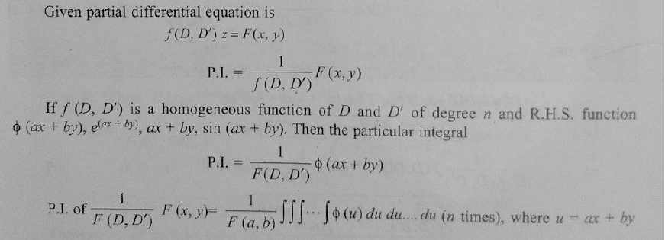
FinD The particular integral

Slide 3
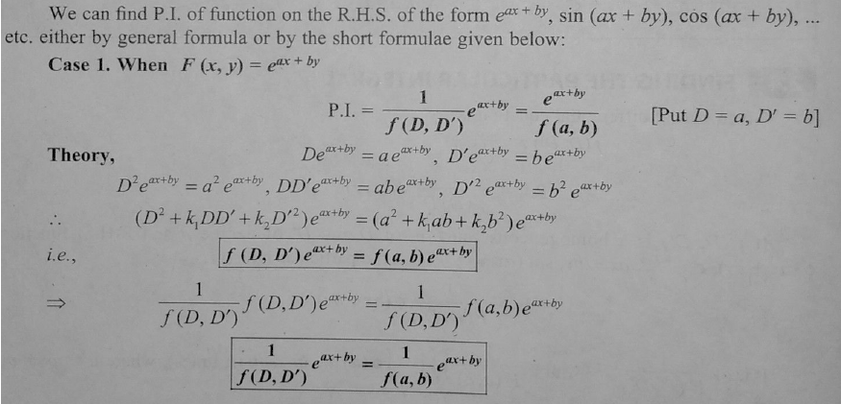
Short formula

Slide 4
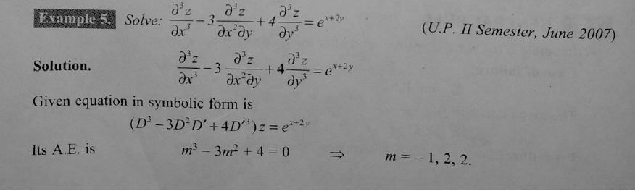
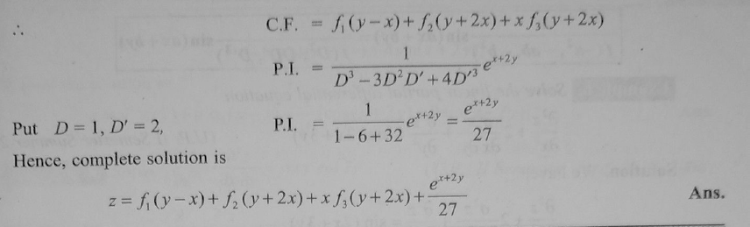

Slide 5
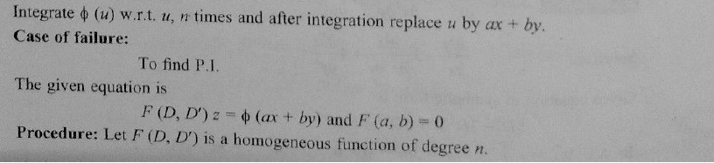

Slide 6
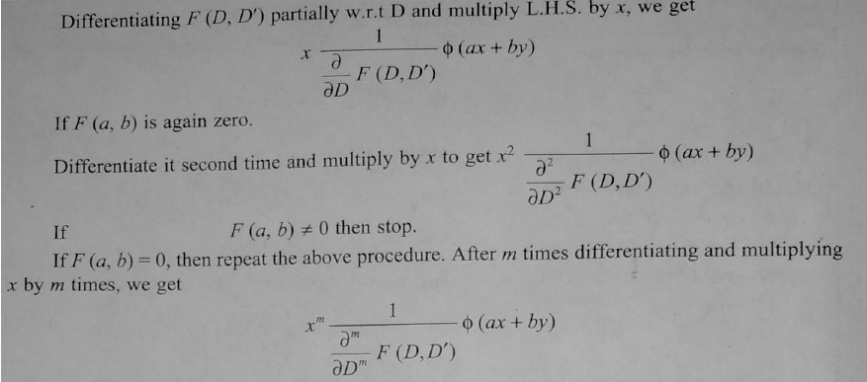
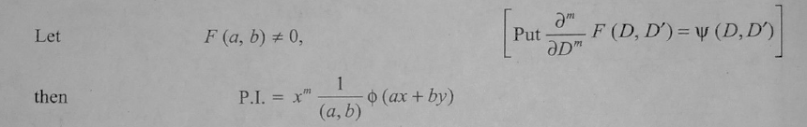

Slide 7
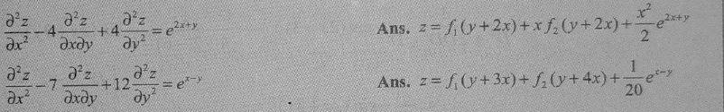
HOME WORK

Slide 8
THANK YOU

